Slide 1
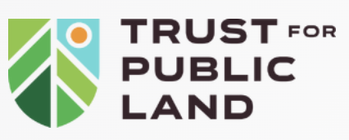
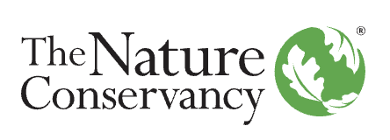
Conservation Finance Initiative
Ten-Year Impact Review (2014-2024)
Prepared by Elizabeth Adams
August, 2025

Slide 2
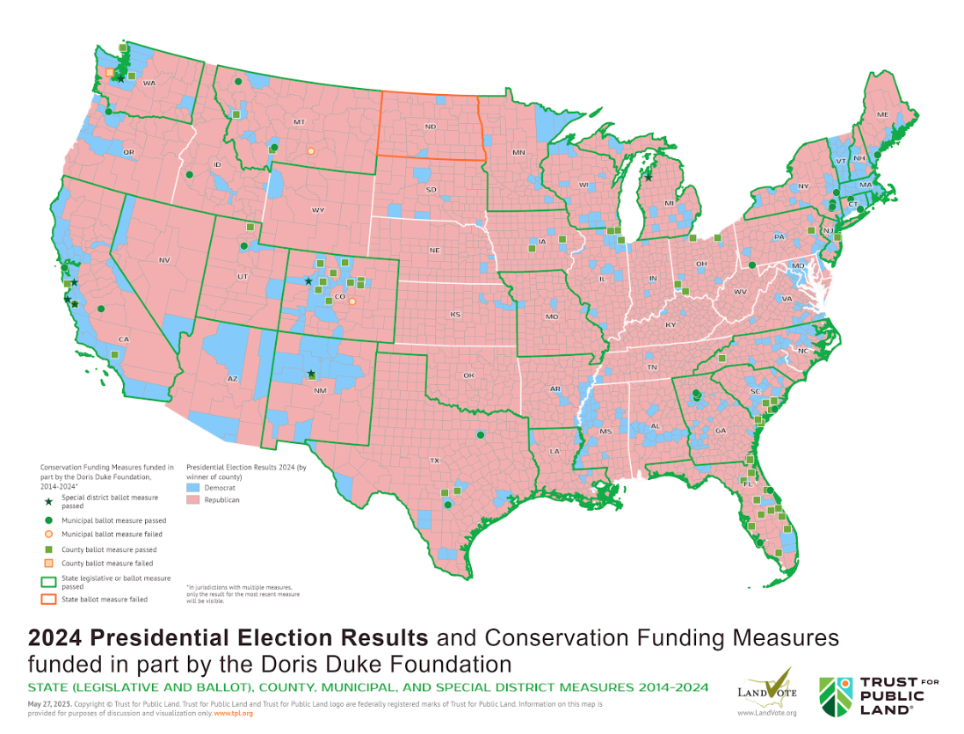
Conservation Wins Across the Political Spectrum
The following map demonstrates bipartisan support for land conservation and the team’s success in working with different types of communities throughout the country. The more Democratic-leaning cities and counties within red states are particularly fertile ground, but they are far from the only places where conservation funding measures succeeded.
Georgia’s Blueprint for Bipartisan Conservation
Georgia’s Outdoor Stewardship Trust Fund, which was overwhelmingly approved by voters with 83% support, raises approximately $20 million per year for conservation, is an example of bipartisan support for conservation in a red state.
It provides a potential blueprint for other states, and similar measures are being considered in Massachusetts (where legislation has been filed), Illinois, Arizona, Colorado and Kentucky.

Slide 3
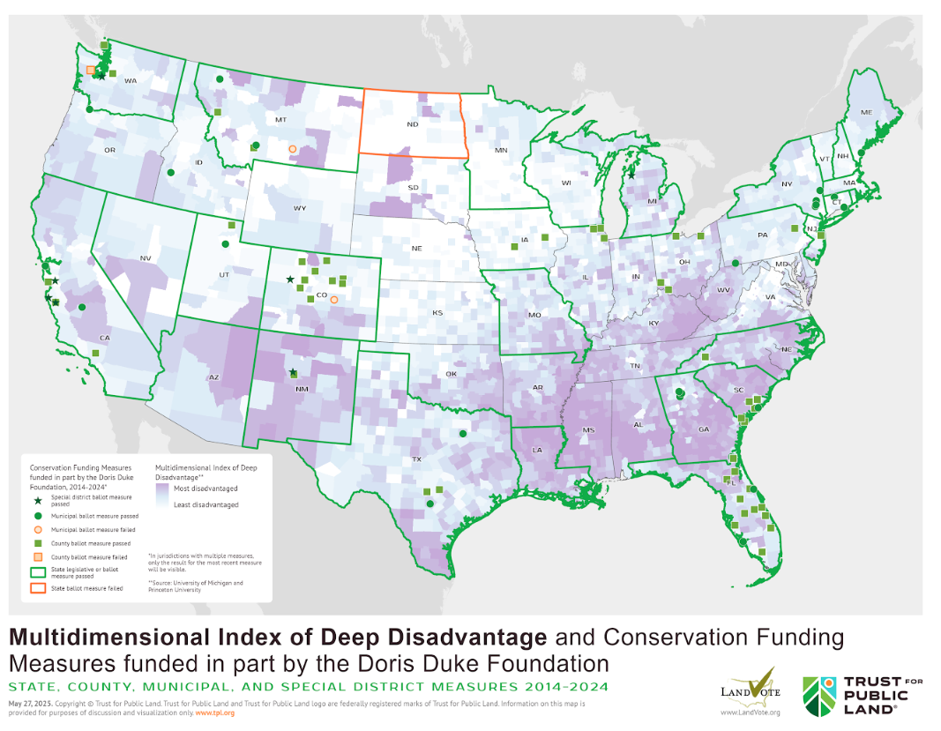
Reaching Disadvantaged Communities
CFI has been more deliberate about building more diverse coalitions and intentionally focusing on creating more conservation funding directed toward under-resourced populations. The map below demonstrates that during the 10-year study period, the team has worked on measures that benefit under-resourced populations - especially statewide measures in places with some of most disadvantaged populations in the U.S.*
Inclusion Drives Success in Minnesota
In Minnesota, voters approved (by 77%) a constitutional amendment dedicating $2.7B in state lottery funds to conservation over 25 years. Starting in 2021 and with support from DDF, CFI and partners built a diverse coalition, engaging Ojibwe Tribe members, BIPOC-led organizations, and community groups. The measure created a new $28M Community Grants Program to expand access for BIPOC and grassroots organizations.
*Although it took place in 2012 outside of the scope of this study, the CFI supported a successful ballot measure in Alabama

Slide 4
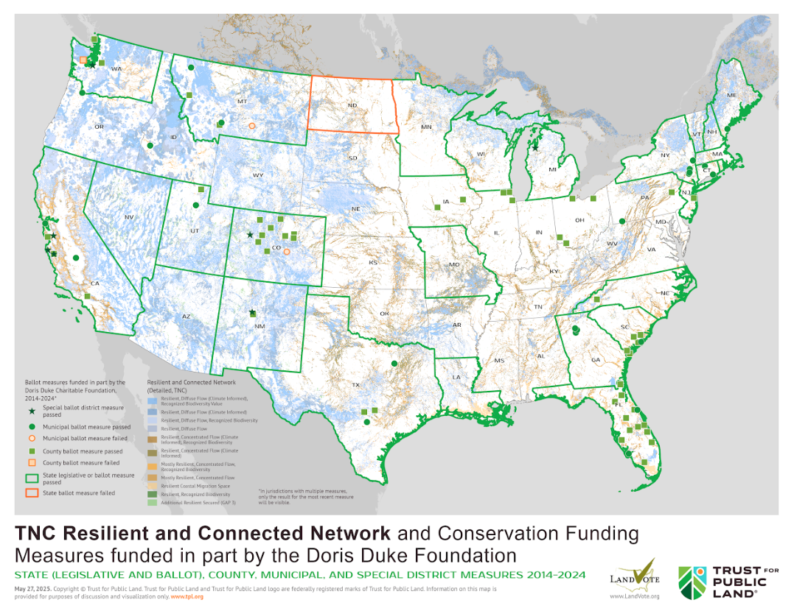
Funding for Resilient and Connected Landscapes
During the review period, a sharper focus on climate resilience has helped ally conservation with broader coalitions and has enabled wins for climate and conservation in multiple jurisdictions. Some of the largest conservation wins in recent years were allied with climate resilience, including state measures in New York, California and Washington and a measure in the City of Denver.
Funding Forest Health and Resilience in Chaffee County, CO (2018)
Voters narrowly approved a ¼-cent sales tax (52%) to protect working lands, improve forest health, and steward recreation areas, generating perpetual funding. While “climate change” language didn’t resonate, wildfire risk did. With 80% public land, thinning and controlled burns became top priorities.

